Slide 1

CAUSE OF DEATH
Prepared by:
Maahi Gurnani, Data Science Intern at Flip Robo Technologies

Slide 2
INTRODUCTION
Problem Statement:
A straightforward way to assess the health status of a population is to focus on mortality – or concepts like child mortality or life expectancy, which are based on mortality estimates.
A focus on mortality, however, does not take into account that the burden of diseases is not only that they kill people, but that they cause suffering to people who live with them. .
Assessing health outcomes by both mortality and morbidity (the prevalent diseases) provides a more encompassing view on health outcomes. .
The sum of mortality and morbidity is referred to as the ‘burden of disease’ and can be measured by a metric called ‘Disability Adjusted Life Years‘ (DALYs). DALYs are measuring lost health and are a standardized metric that allow for direct comparisons of disease burdens of different diseases across countries, between different populations, and over time.
The first ‘Global Burden of Disease’ (GBD) was GBD 1990 and the DALY metric was prominently featured in the World Bank’s 1993 World Development Report.

Slide 3
Motivation for the Problem Undertaken:
Measuring how many people die each year and why they have died is one of the most informative ways of assessing the effectiveness of a country’s health system. Mortality data allow health authorities to evaluate how they prioritize public health programs.
Aggregation was done over estimates of “Total Deaths”, “Deaths by Cause” and by “Country/ Territory” to estimate regional and global cause specific mortality rates.

Slide 4
Analytical Modelling of the Problem
1) Checking the year wise count of total deaths from 1990-2019
-Displaying Total Deaths of all Countries in Descending order
2) Analysis with respect to either
Each Disease that has affected which Top 10 Countries ‘or’
10 Diseases of each Country

Slide 5
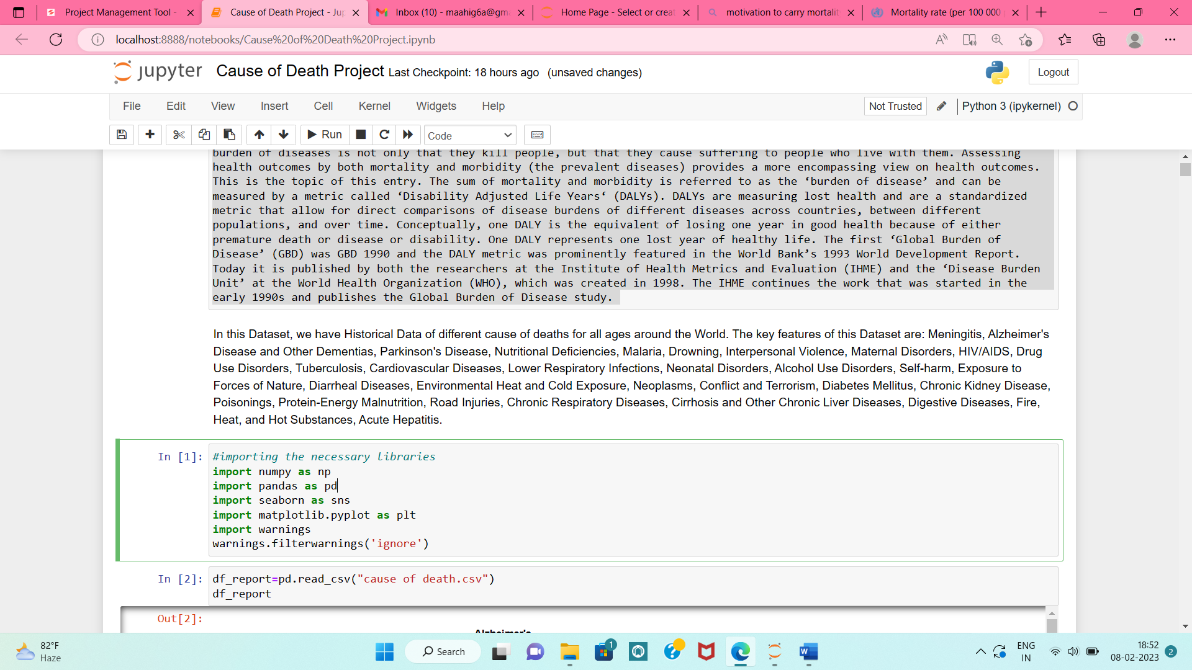
Hardware and Software Requirements and Tools Used
Languages Used: Python
Platform Used: Jupyter Notebook
Libraries and Metrics used:
Following are the libraries and metrics used to carry out our Analysis:

Slide 6
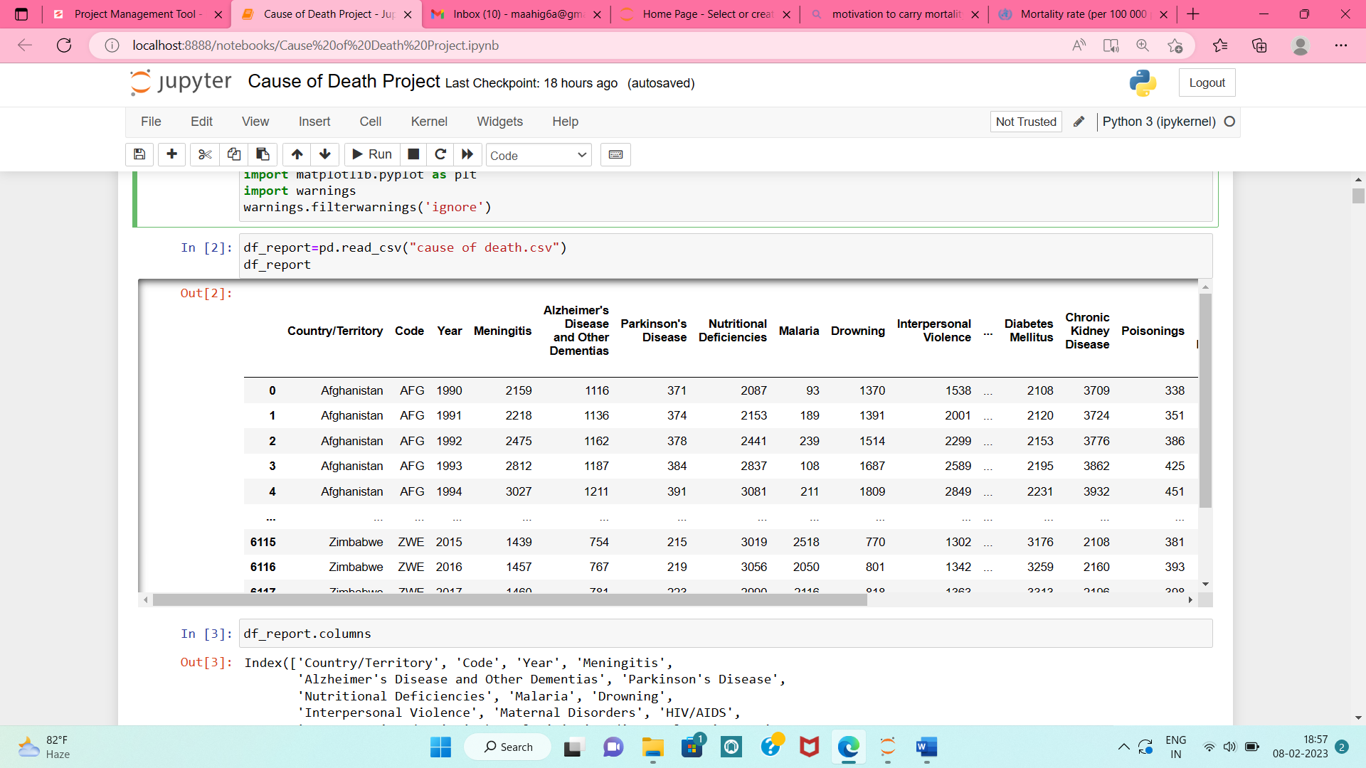
Data Sources
In this Dataset, we have Historical Data of different cause of deaths for all ages around the World
There are total 34 columns, of which 31 are the various causes of disease and 6120 rows containing 30 years data(1990-2019) of 204 Countries

Slide 7
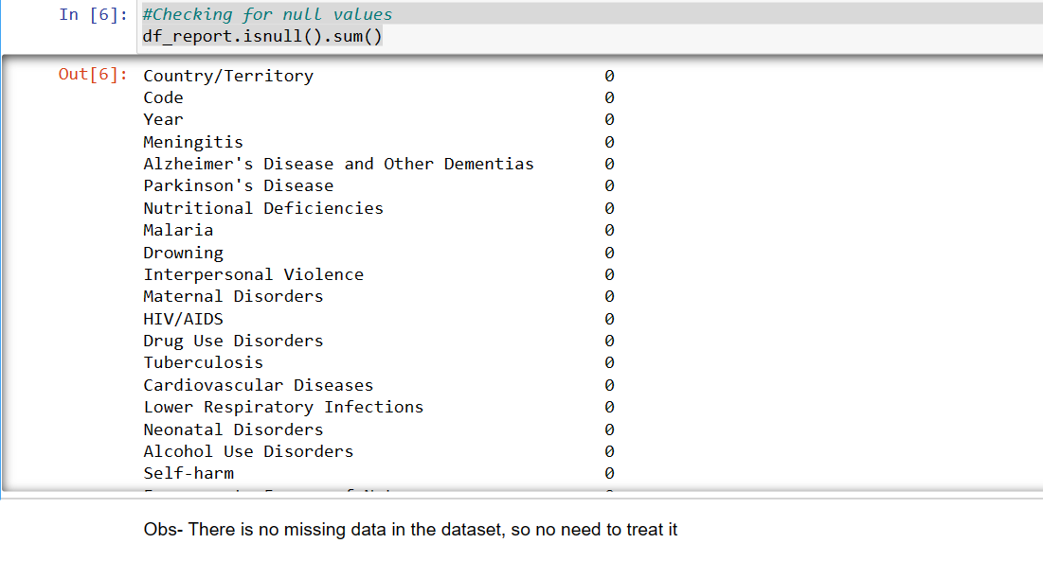
Data Pre-processing
1. Checking For Null Values: df_report.isnull().sum()

Slide 8
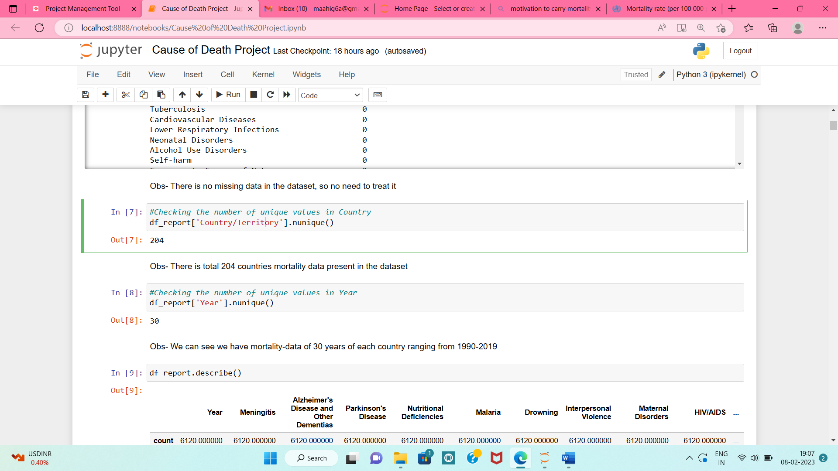
2.Checking for Country Count
df_report['Country/Territory'].nunique()
3. Checking for total number of Years Count
df_report['Year'].nunique()

Slide 9
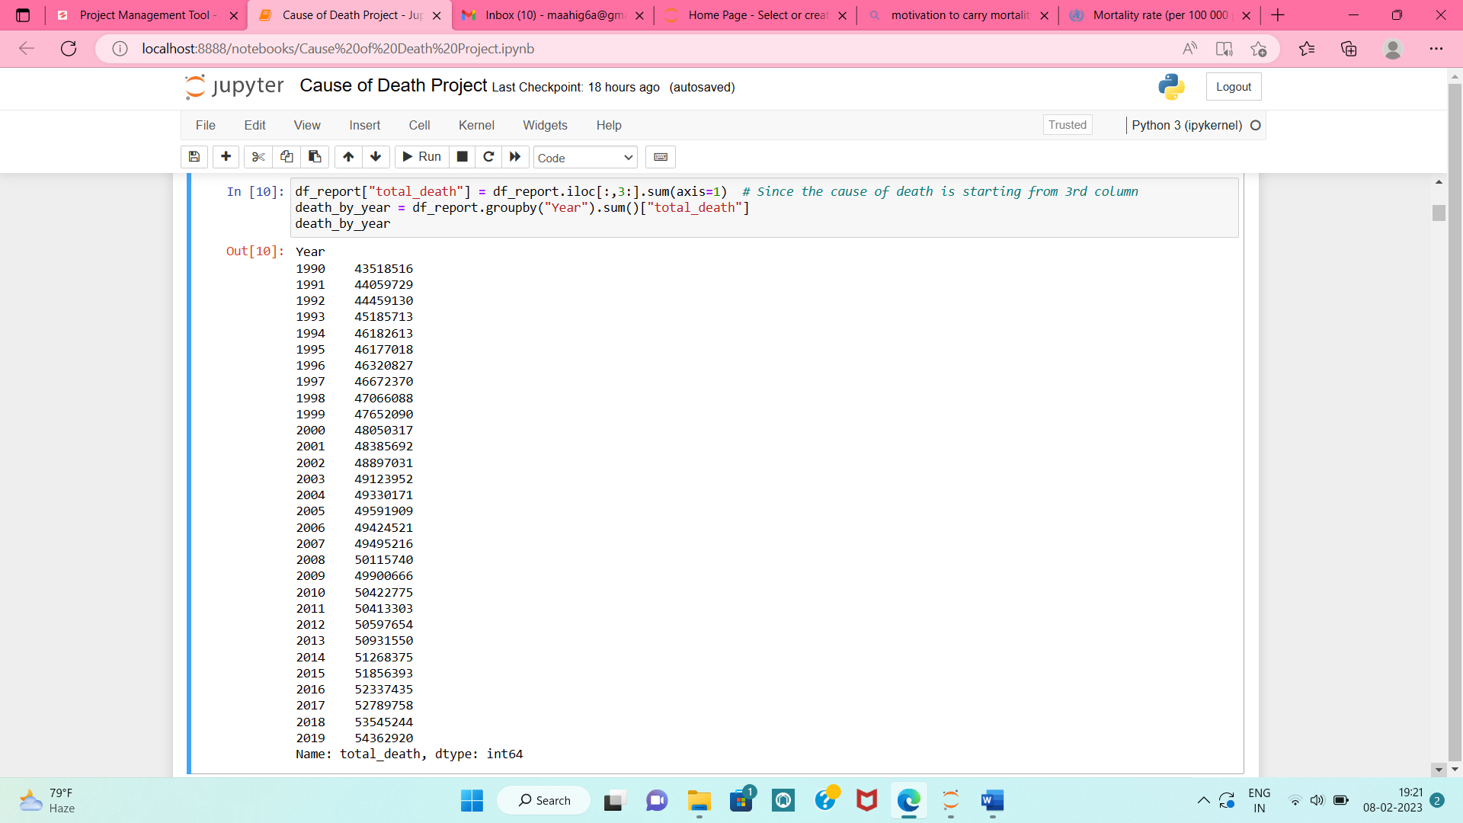
Data Analysis & Visualization
1. Checking the year wise count of total deaths from 1990-2019

Slide 10
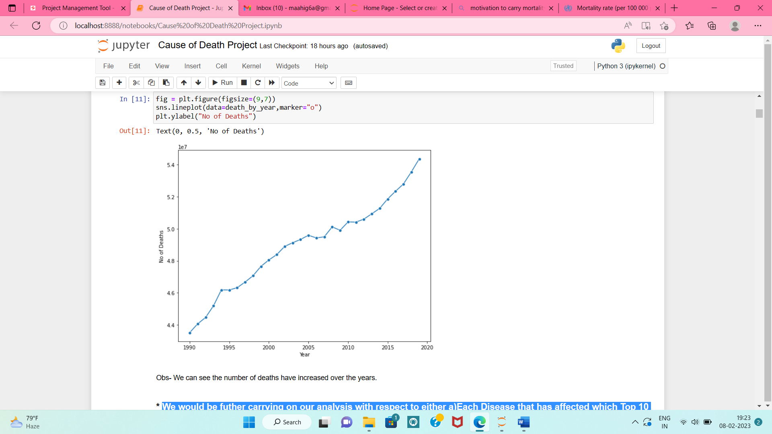
1.1 Plotting a line plot to check total deaths of all years(1990-2019)

Slide 11
• Further Analysis:
We carried on our analysis with respect to either :
a) Each Disease (Cause_of_death) that has affected which Top 10 Countries ‘or’
b) Top 10 Diseases of each Country
throughout so as to get detailed insights of which country has been affected the most and with which disease.
• Steps Followed :
We want to take a look at the total global deaths and which countries lead in total deaths.
Thus, we are aggregating across the DataFrame and would therefore drop the 'Year' column.
c) And the Total Global Deaths from 1990-2019 will be displayed at end

Slide 12
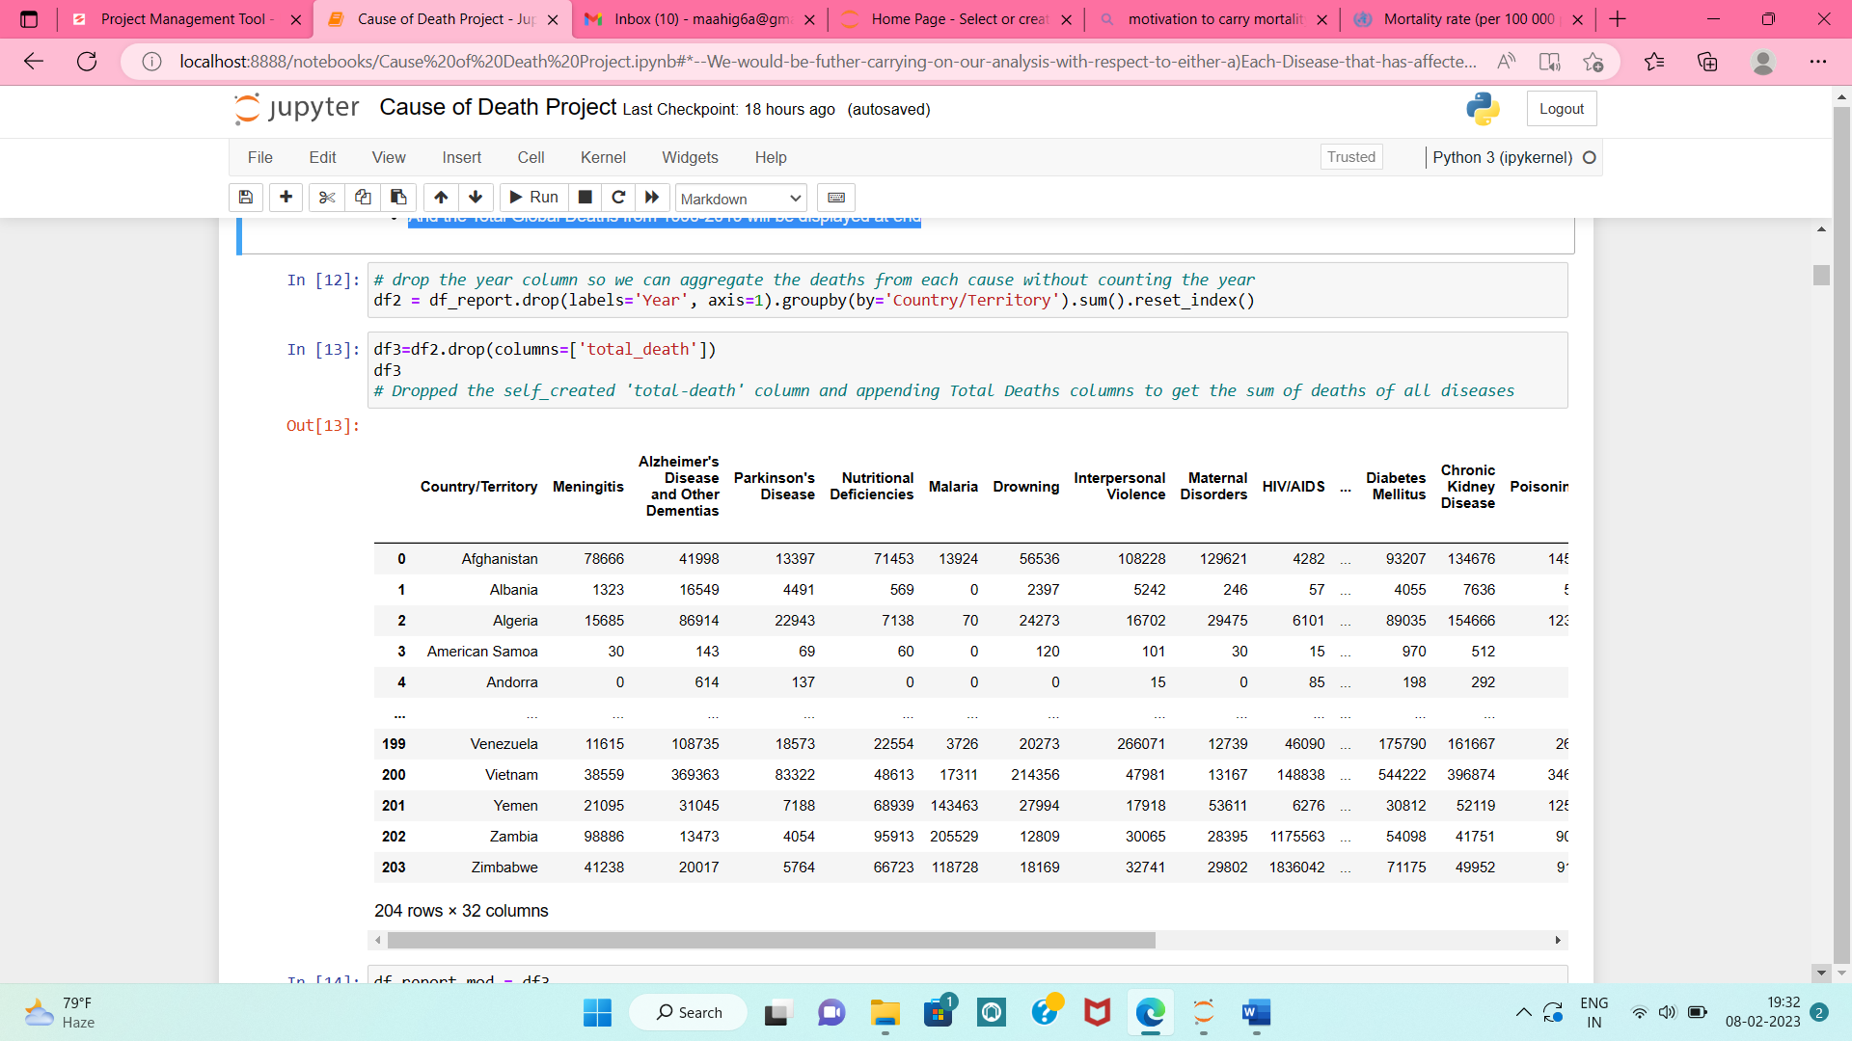

Slide 13
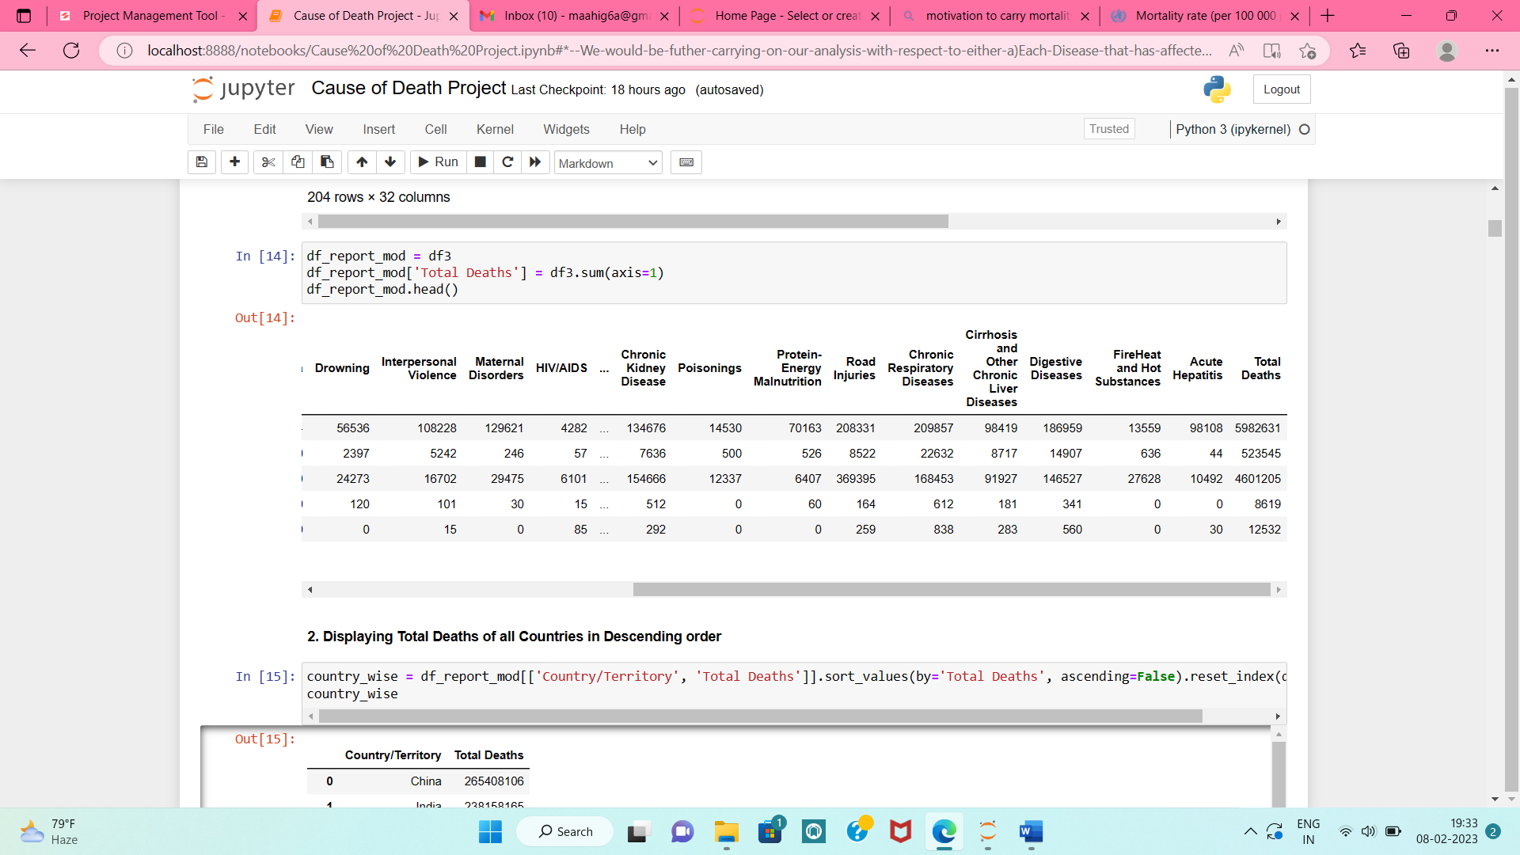

Slide 14
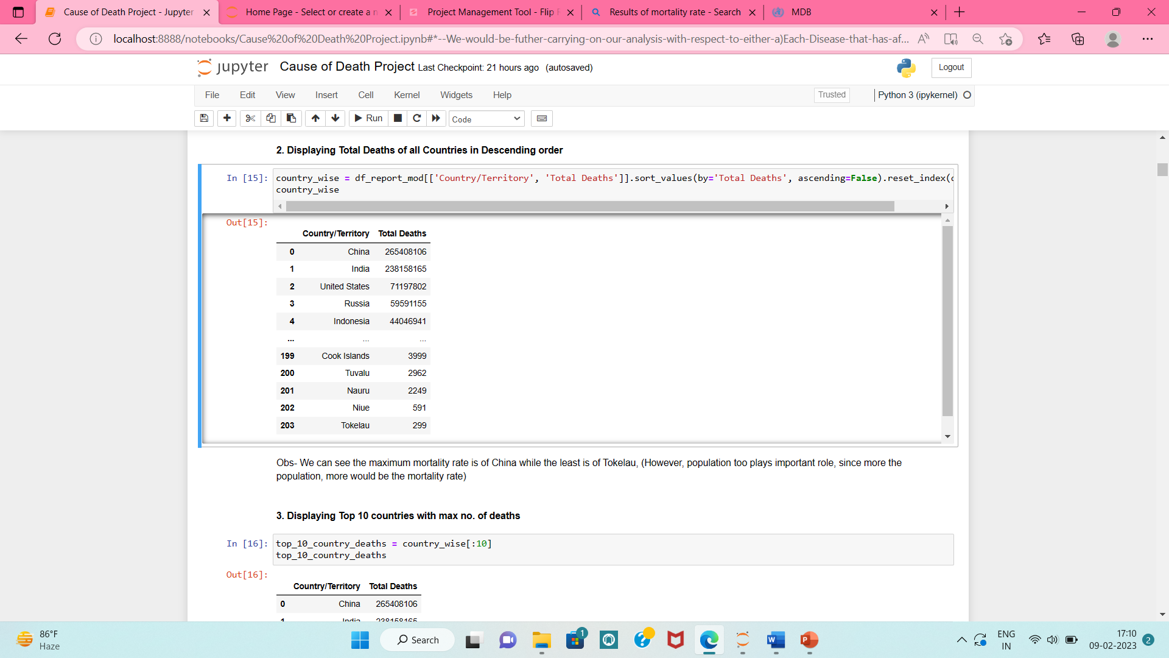
2.Displaying Total Deaths of all Countries in Descending order

Slide 15
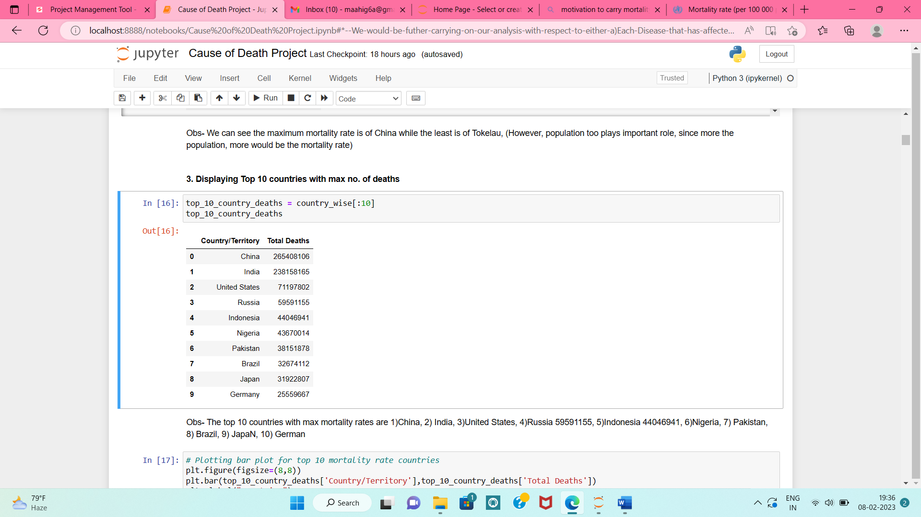
3. Displaying Top 10 countries with max no. of deaths

Slide 16
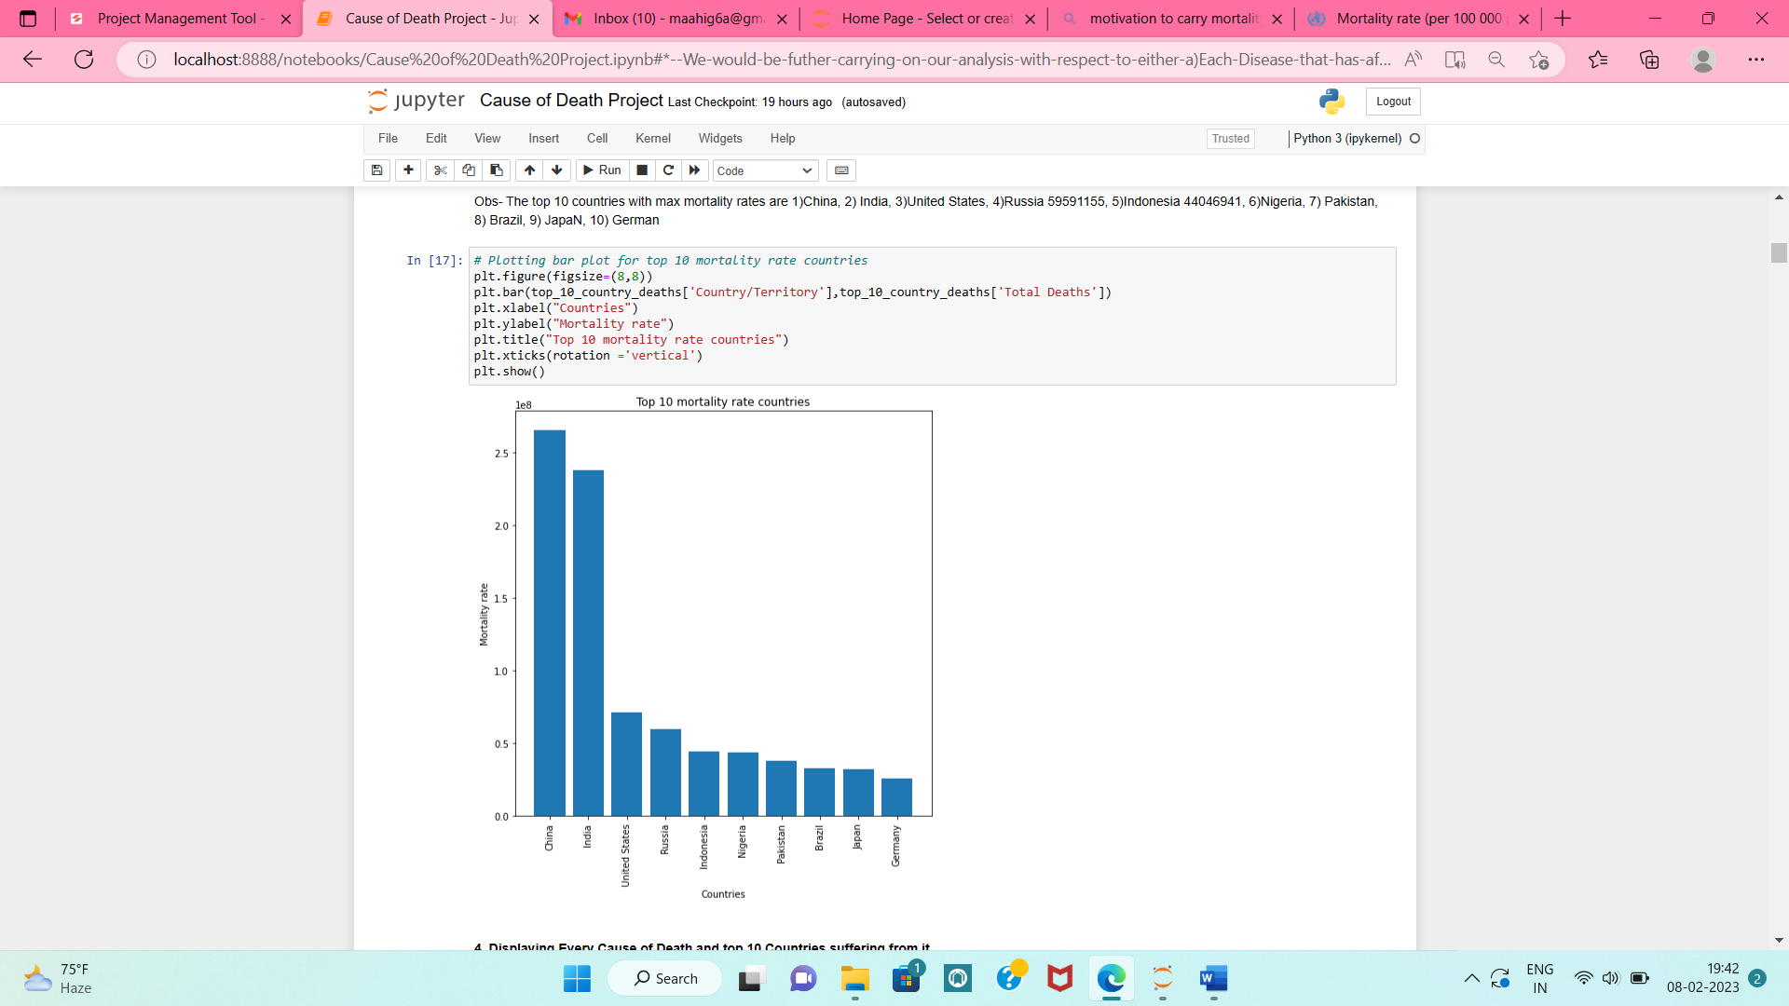
3.1 Plotting a bar plot to view top 10 Countries death rates

Slide 17
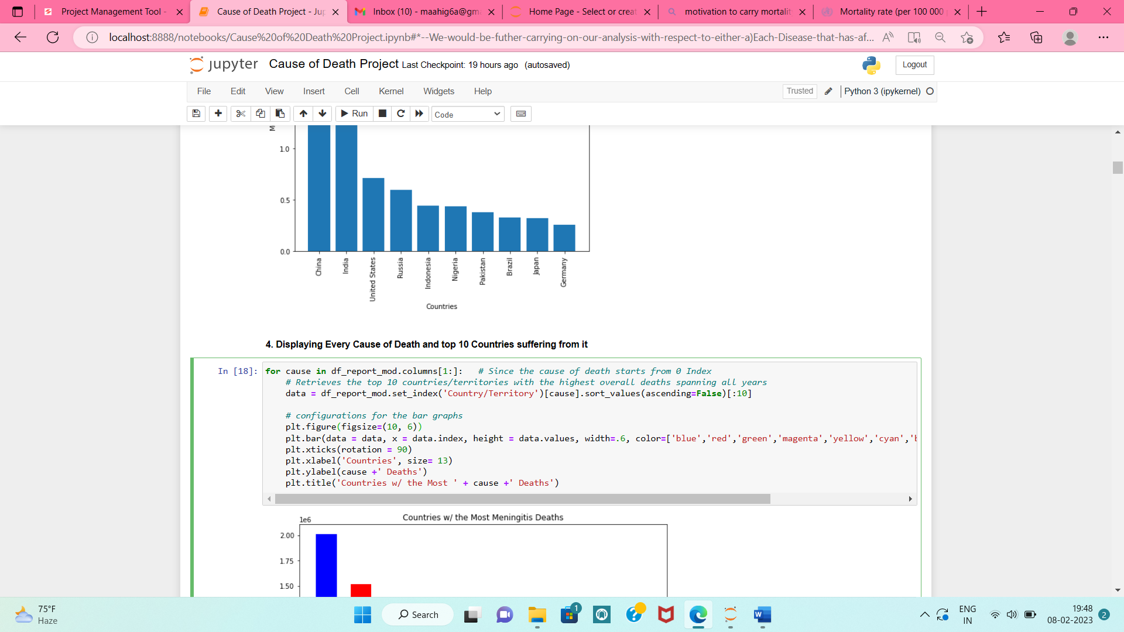
4. Displaying Every Cause of Death and top 10 Countries suffering from it
• We have taken every cause of death and have extracted the top 10 Countries (Sort function) suffering from that particular disease and plotted bar plots for the same

Slide 18
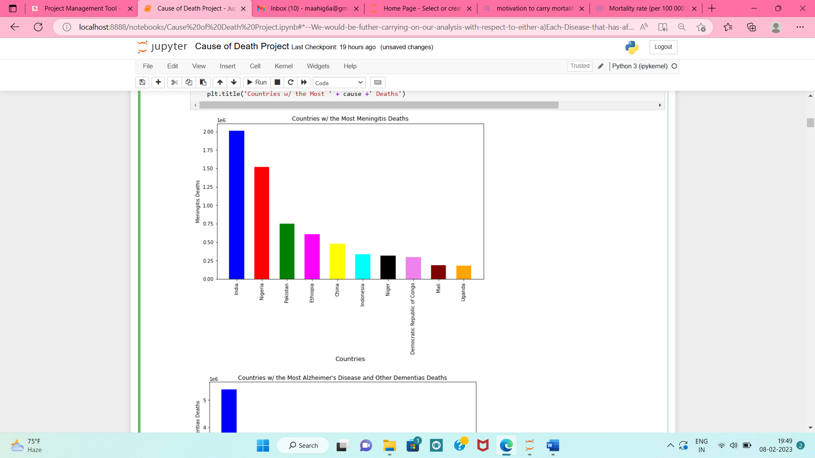
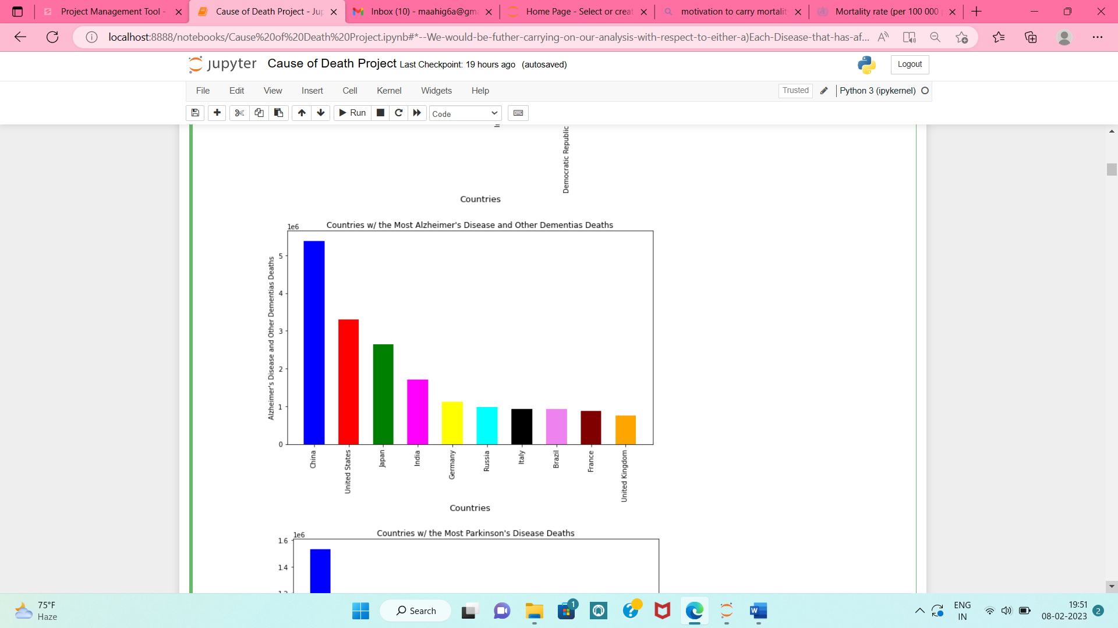
4. 1 Snapshots of few cause_of_deaths below:

Slide 19
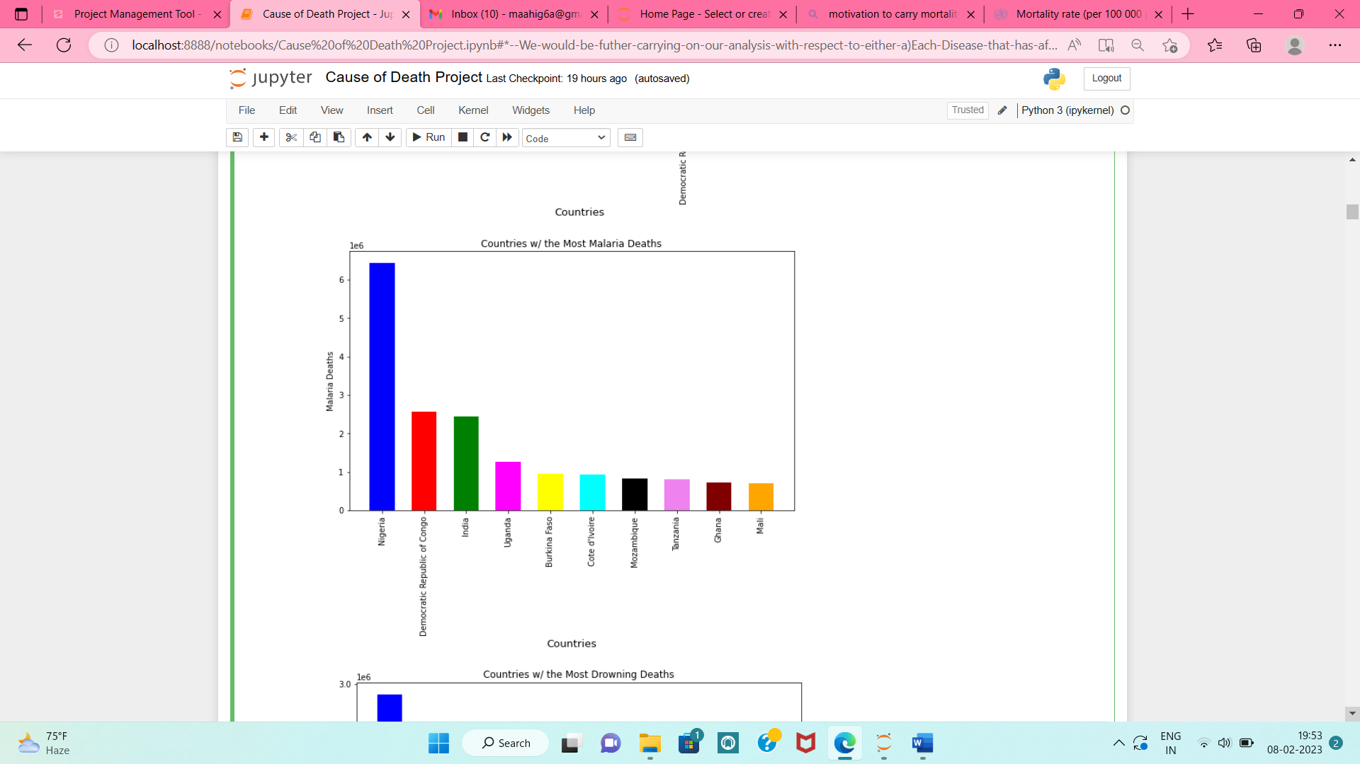
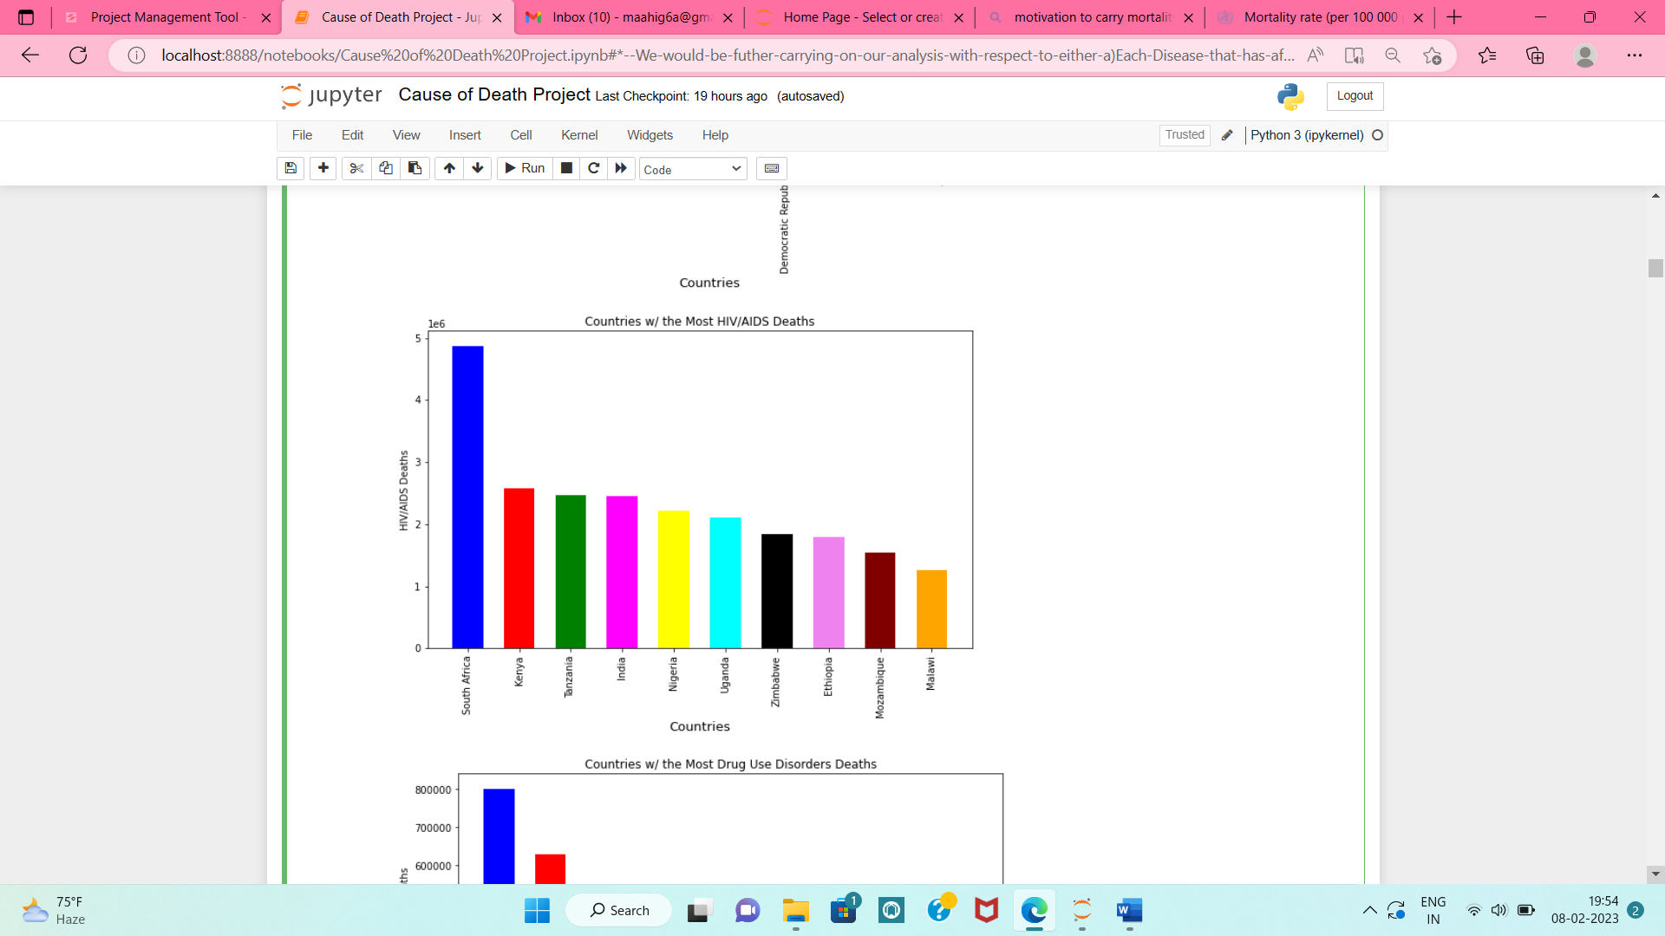

Slide 20
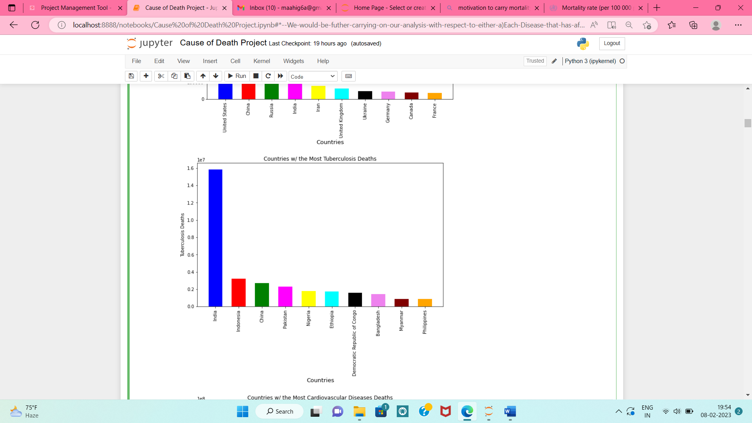
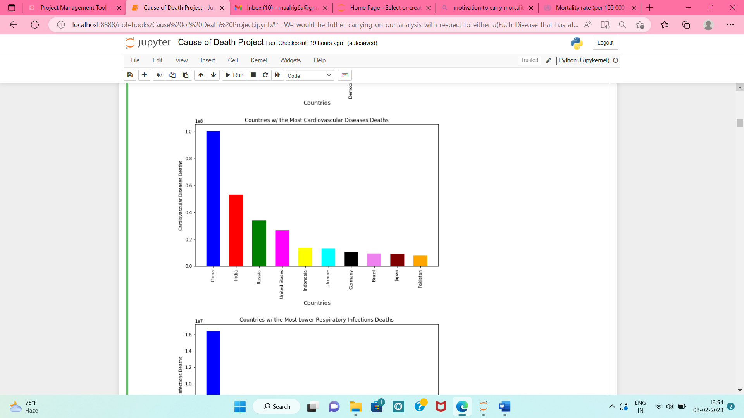

Slide 21
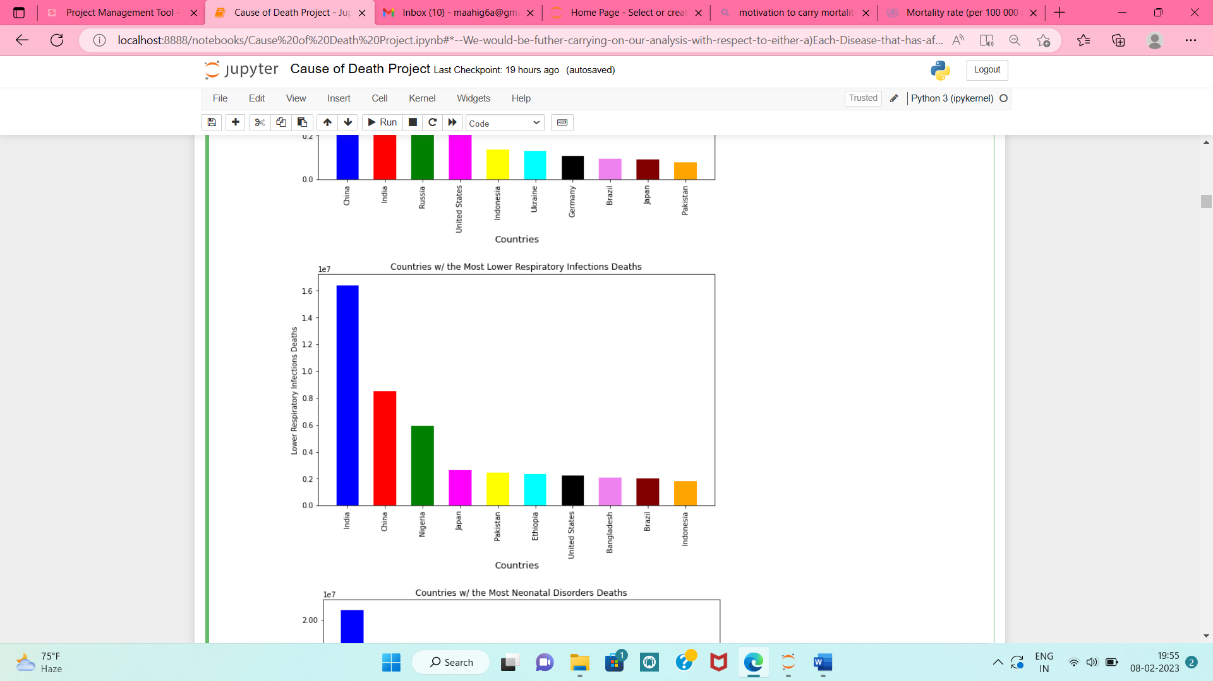
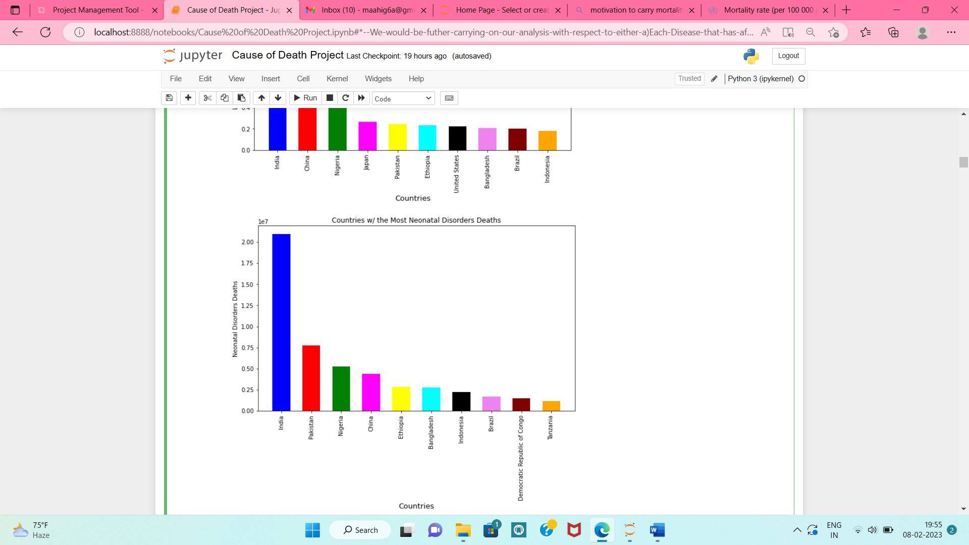

Slide 22
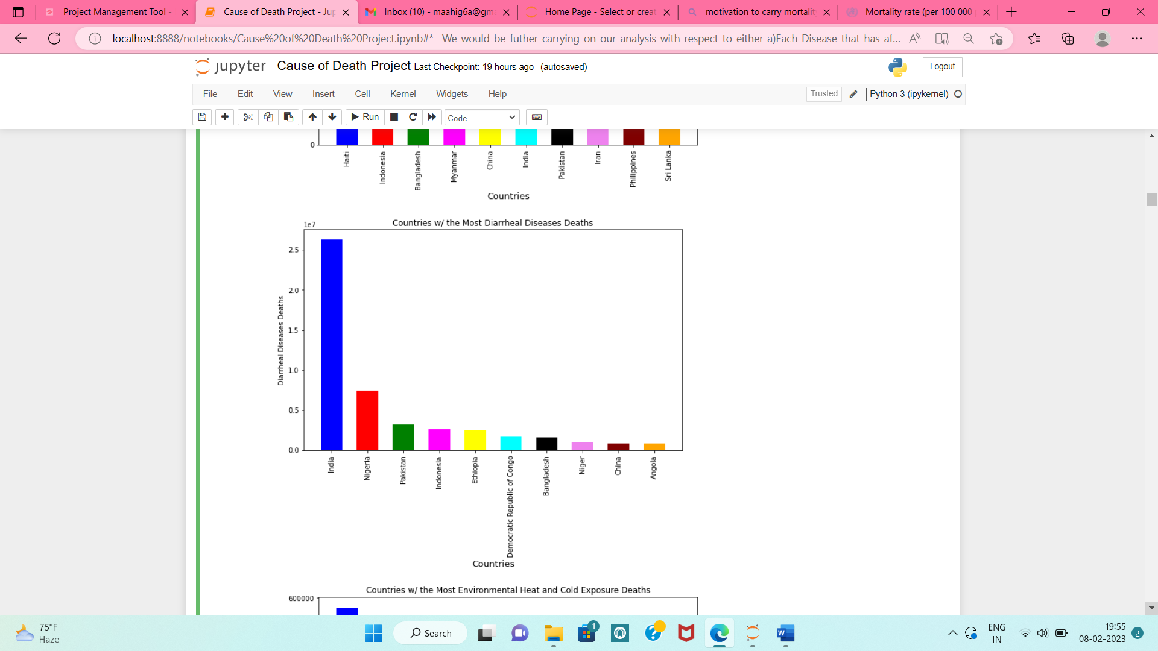
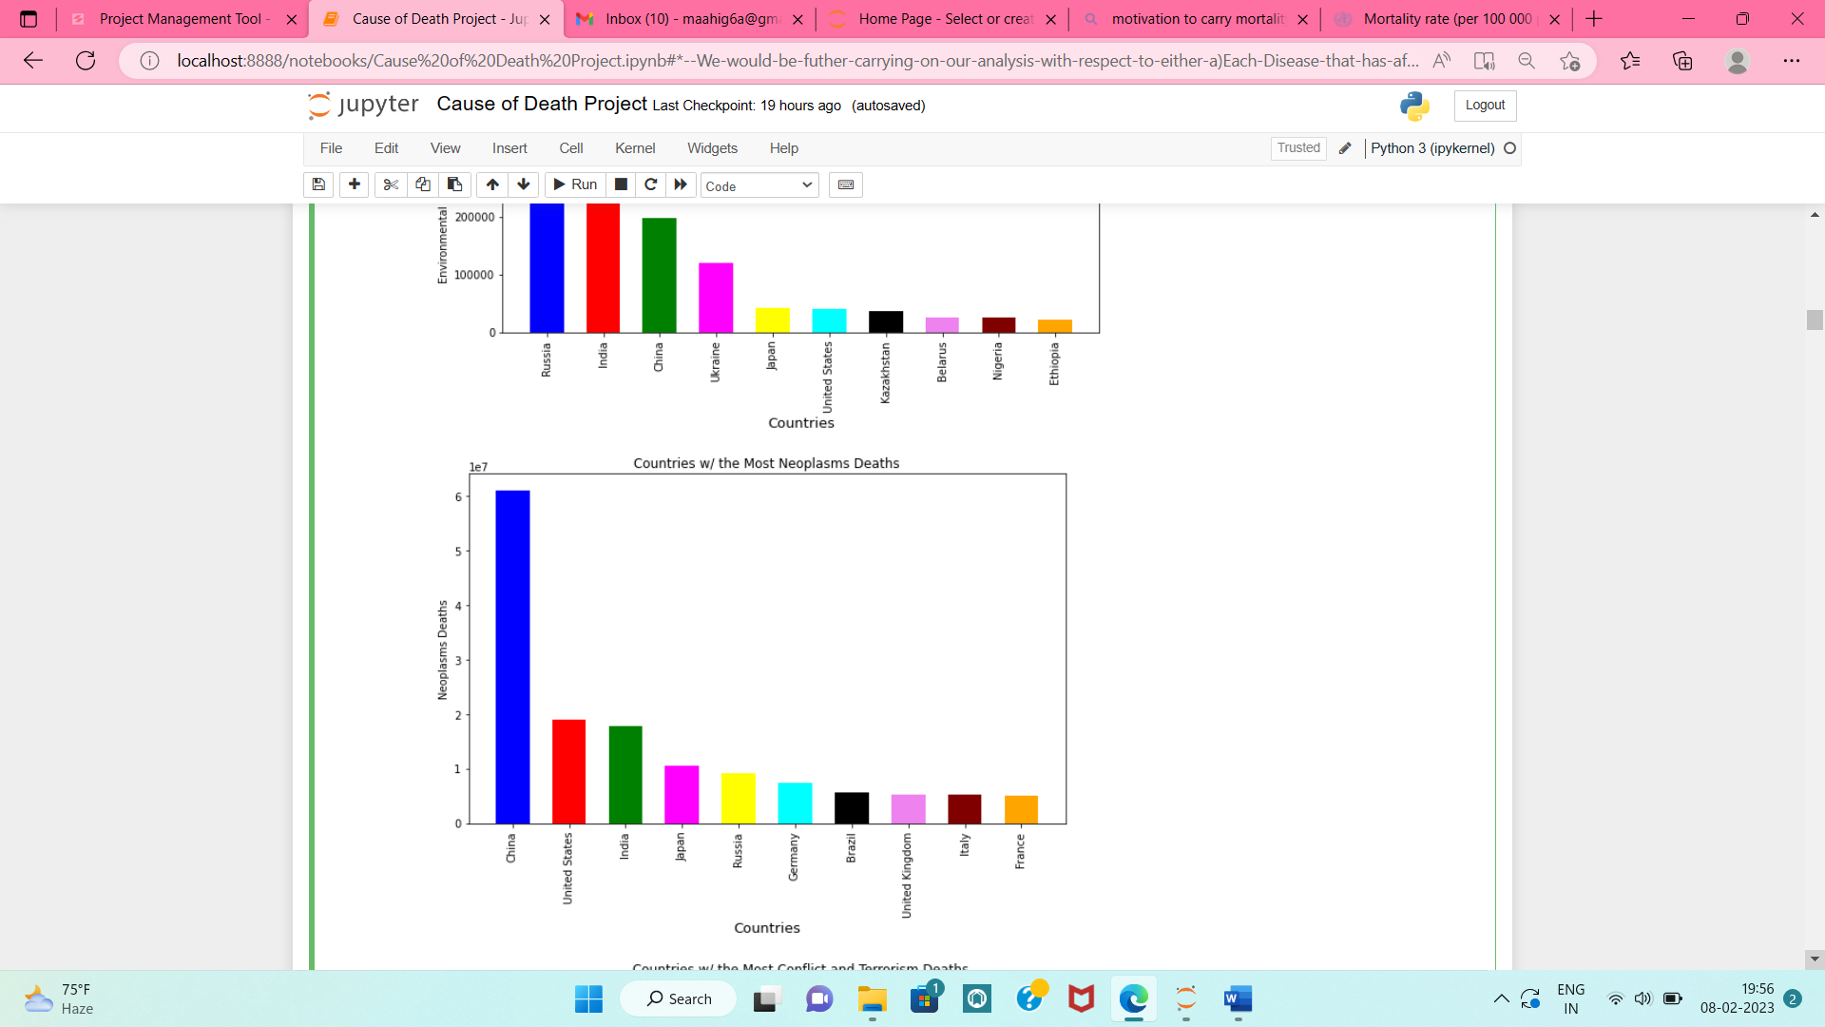

Slide 23
Key Observations:
The important observation noticed was India is leading in death-rates and that too with so high ratio in most causes-of-death, which shows there is lot of scope of improvement in medical facilities in India.
The other countries following India in most death rates in most causes-of-death is China, Indonesia, United States, Ethiopia(Even though population is less, death rates comparatively are very high)

Slide 24
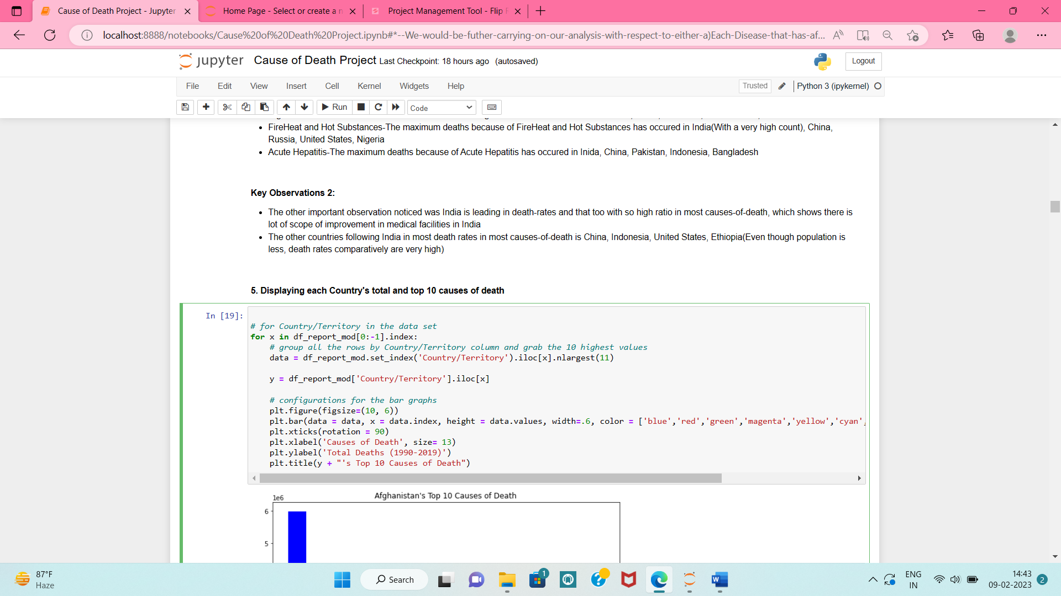
5. Displaying each Country's total and top 10 causes of death
• For displaying top 10 causes and total count’s death, we have selected first 11 largest count entries of each country and displayed in the form of bar graph.

Slide 25
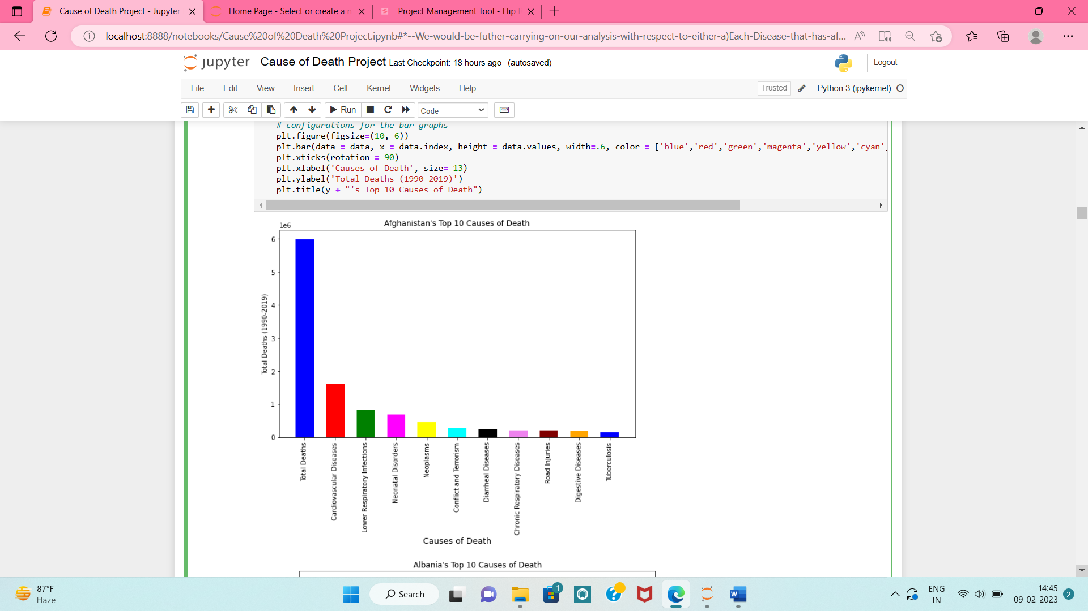
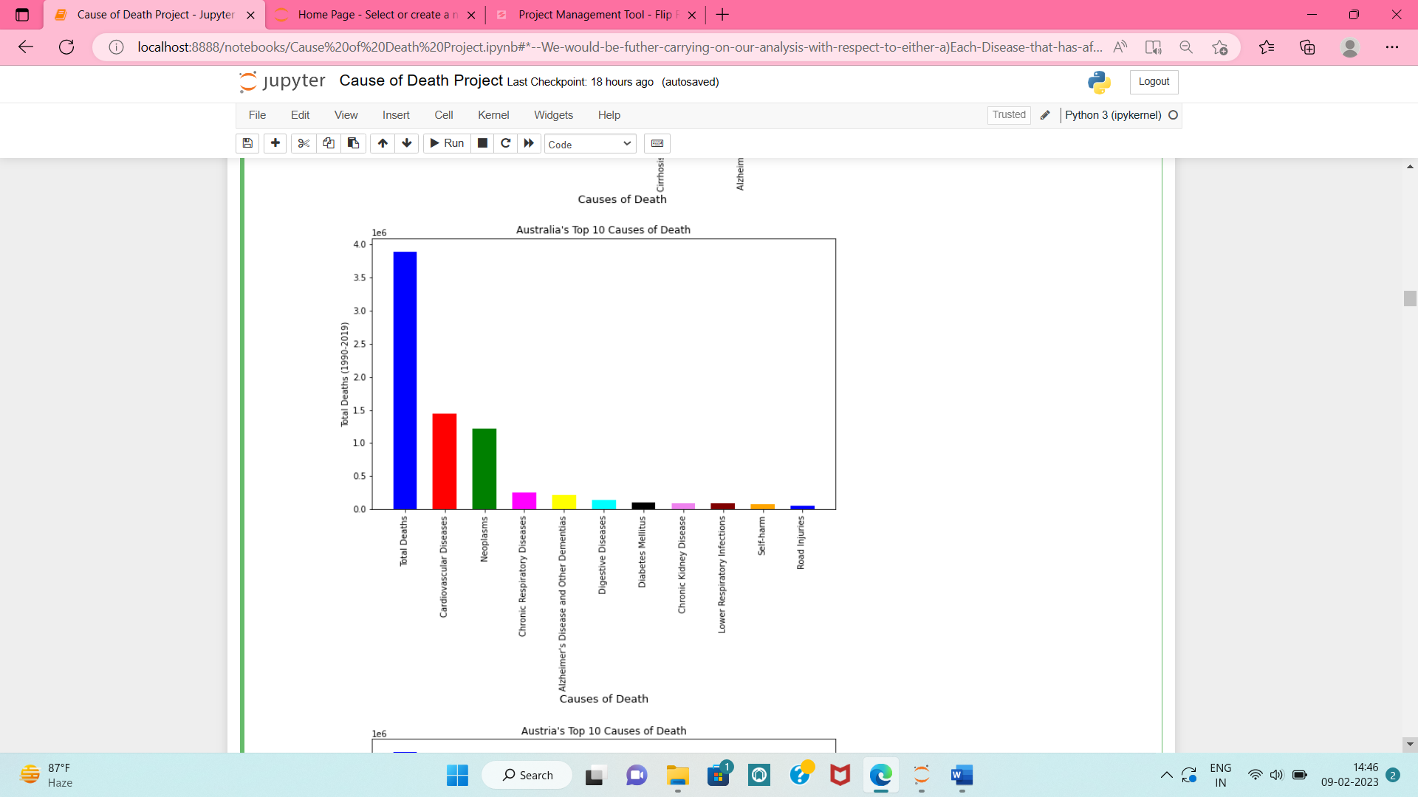
Snapshots of few Countries with their top causes of death:

Slide 26
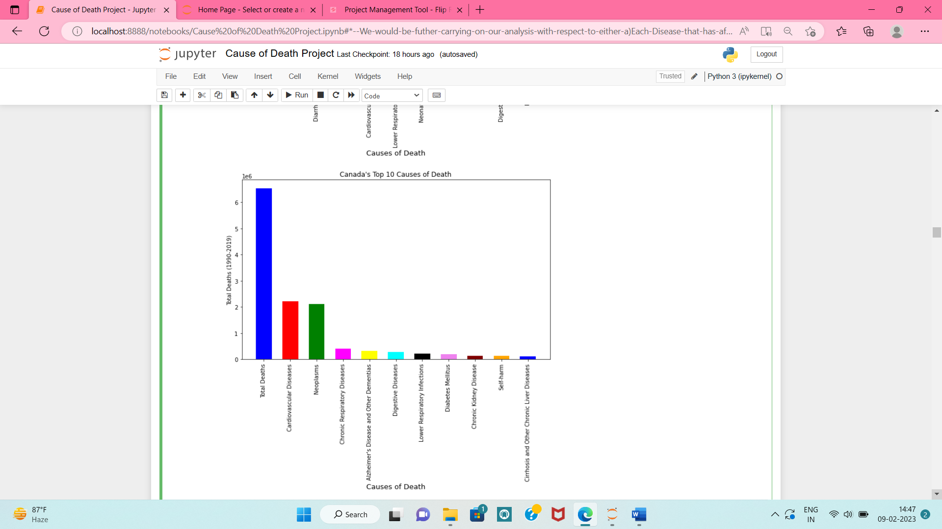
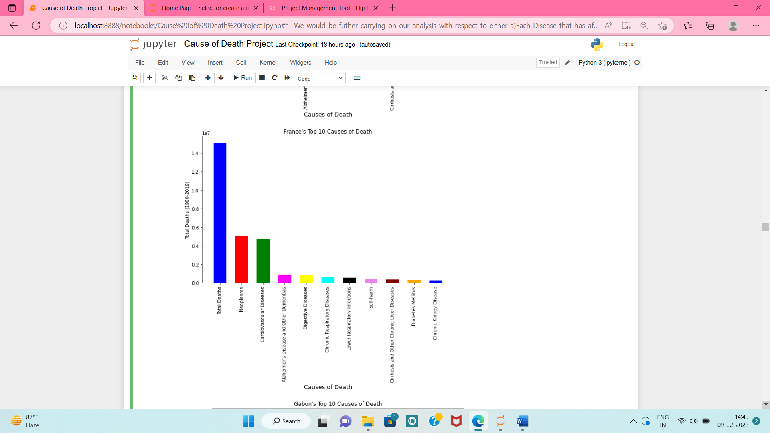

Slide 27
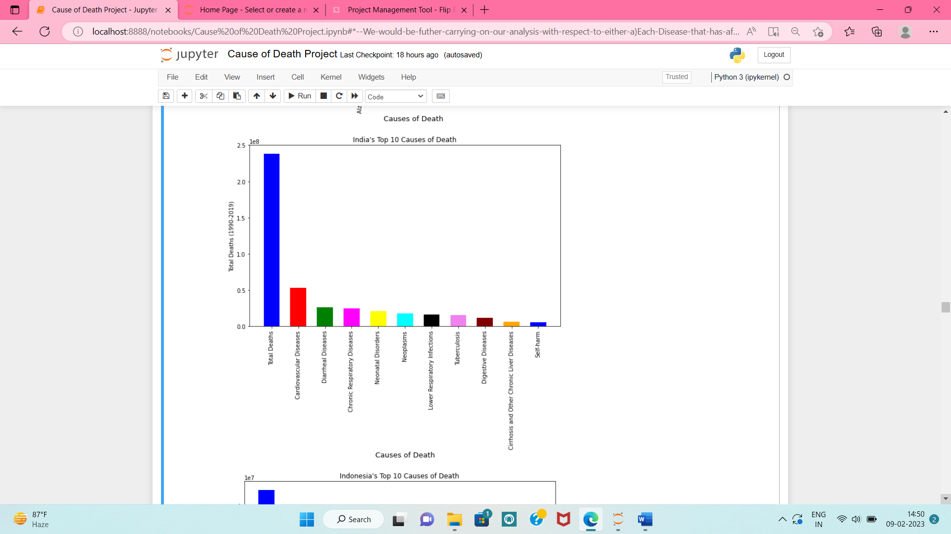
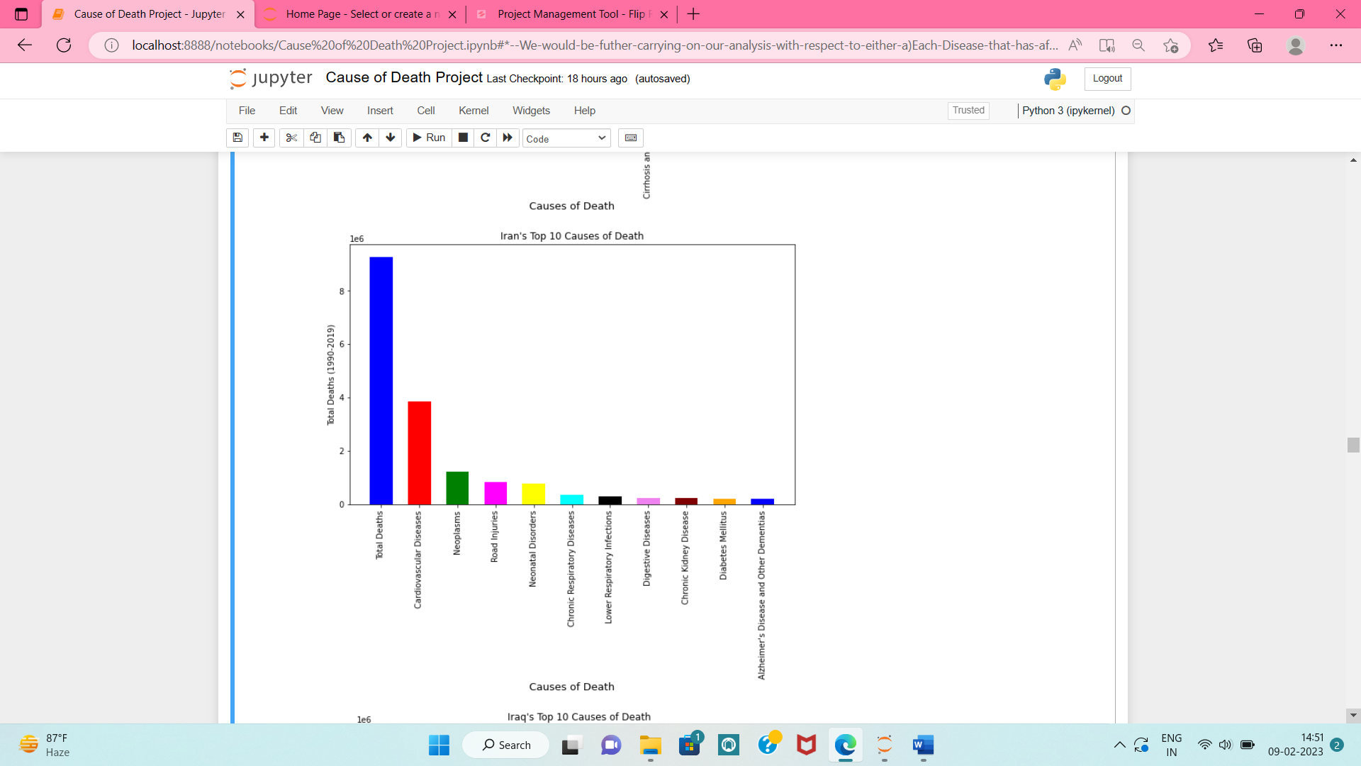

Slide 28
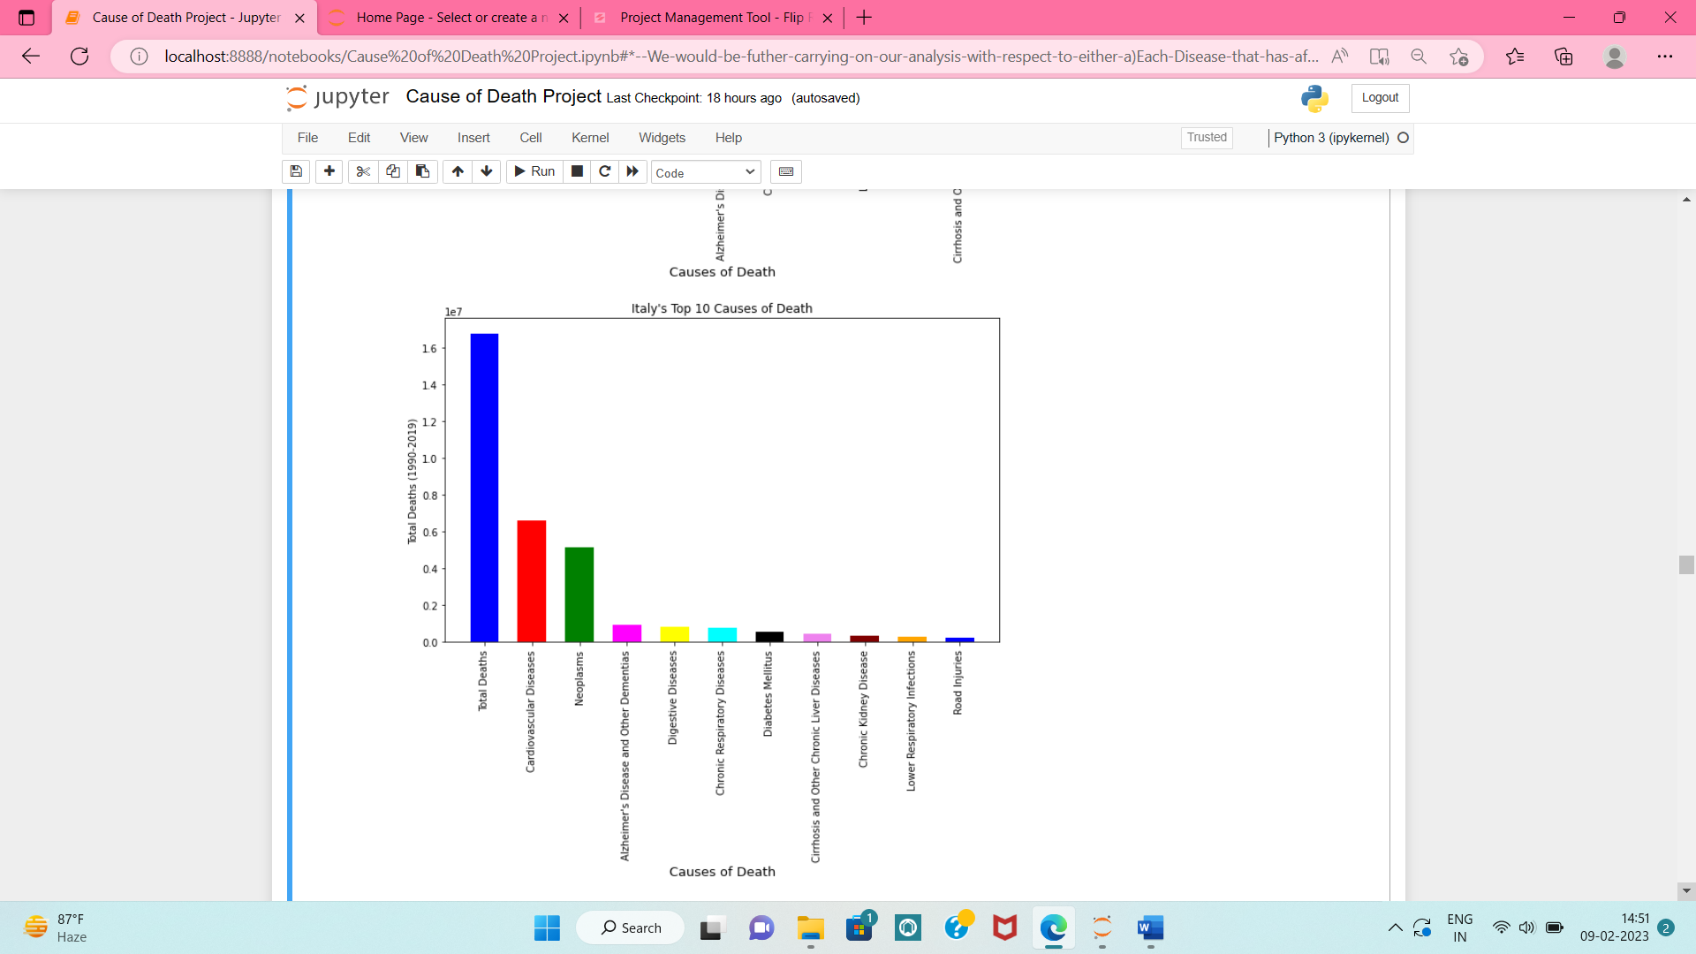
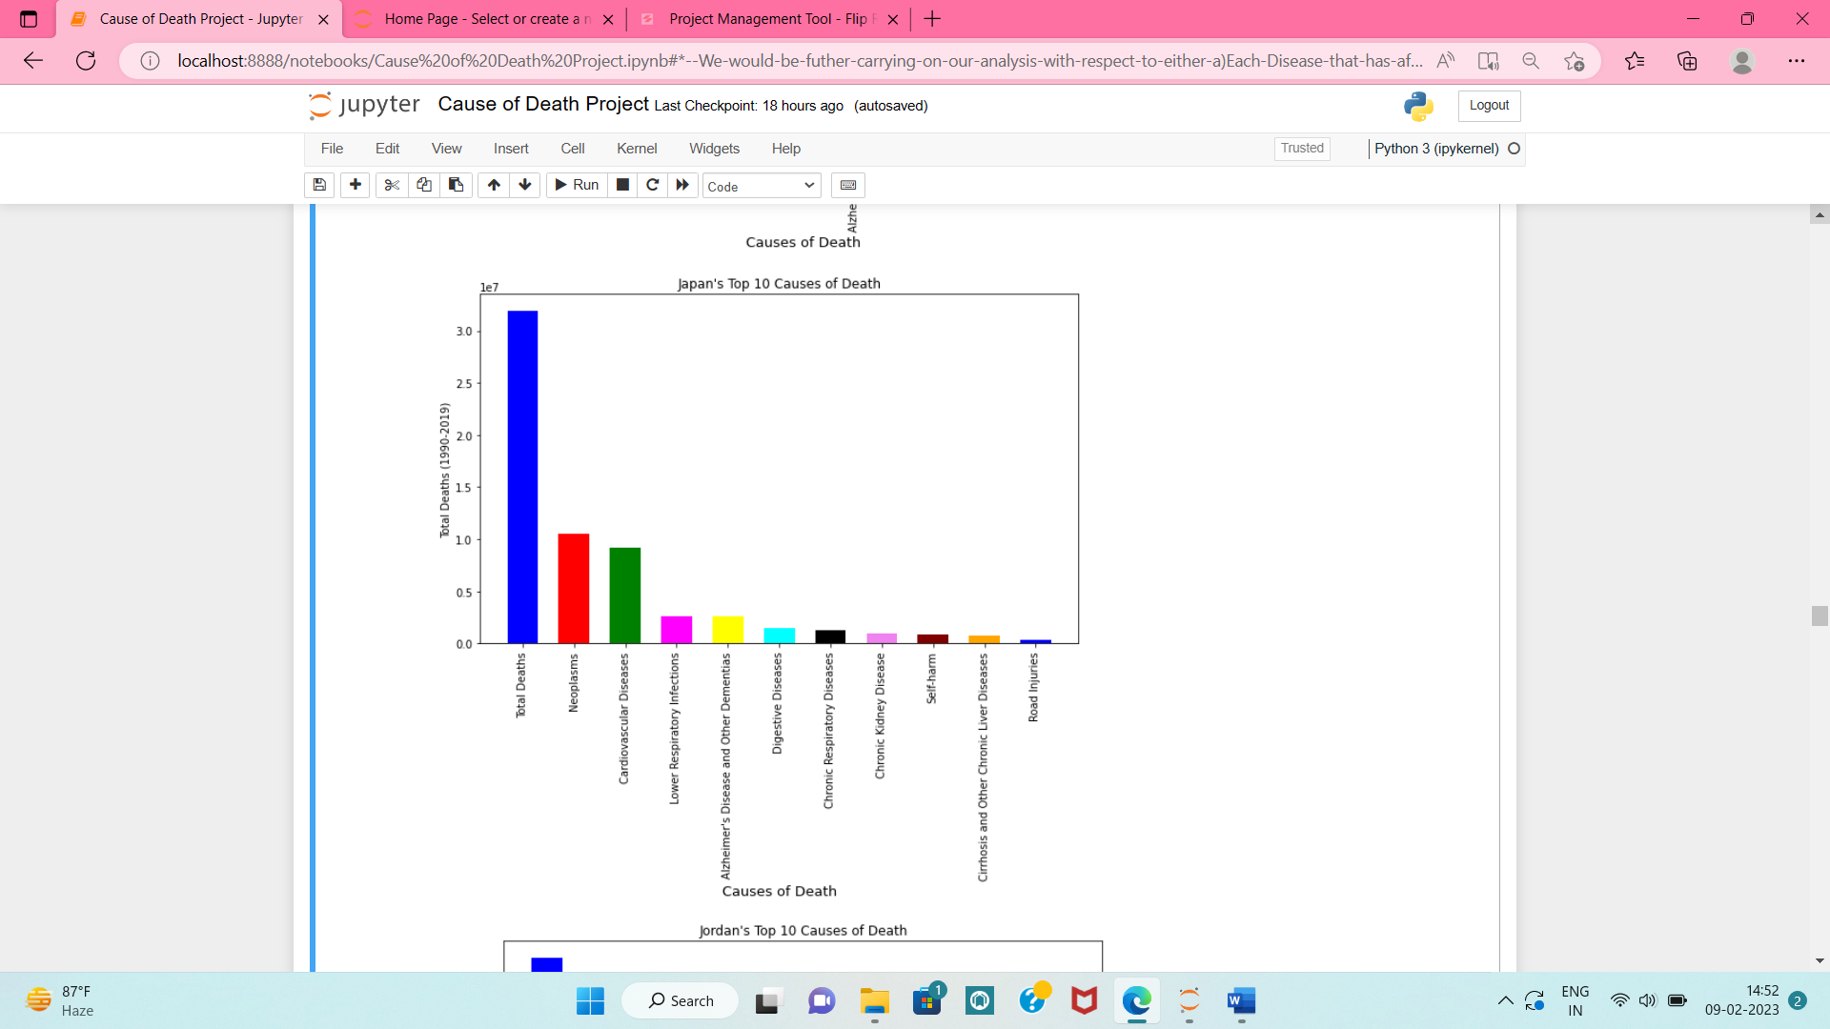

Slide 29
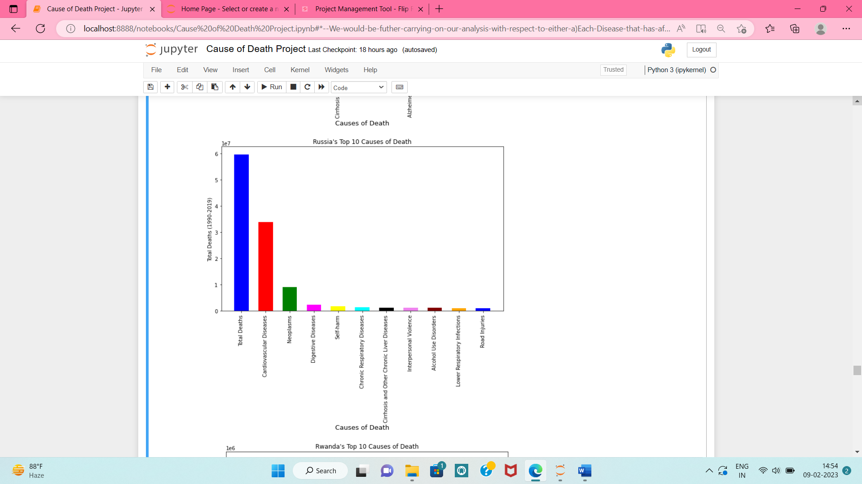
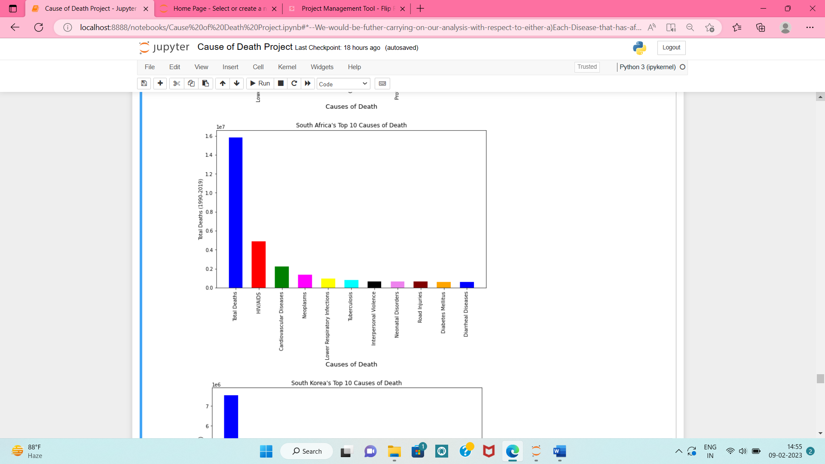

Slide 30
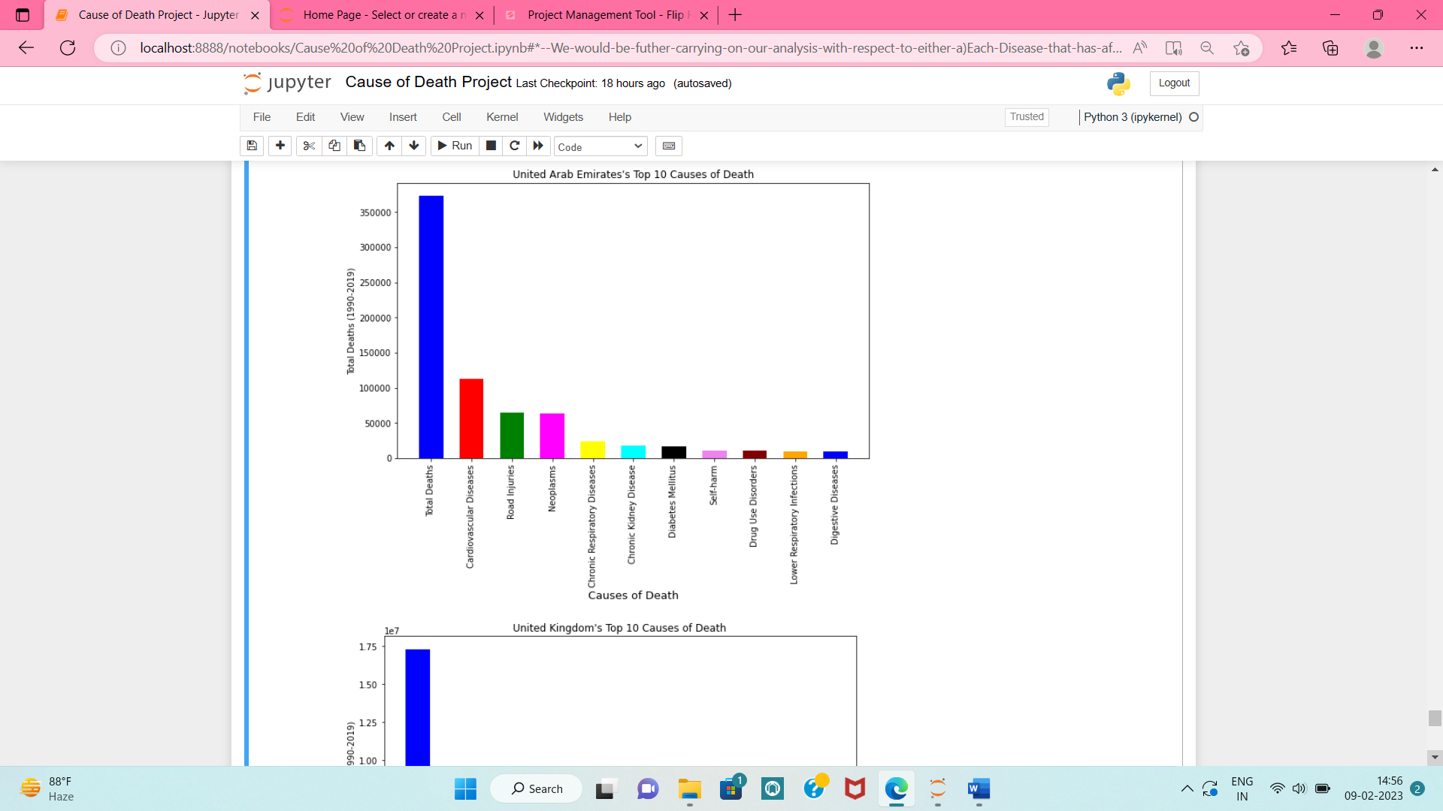
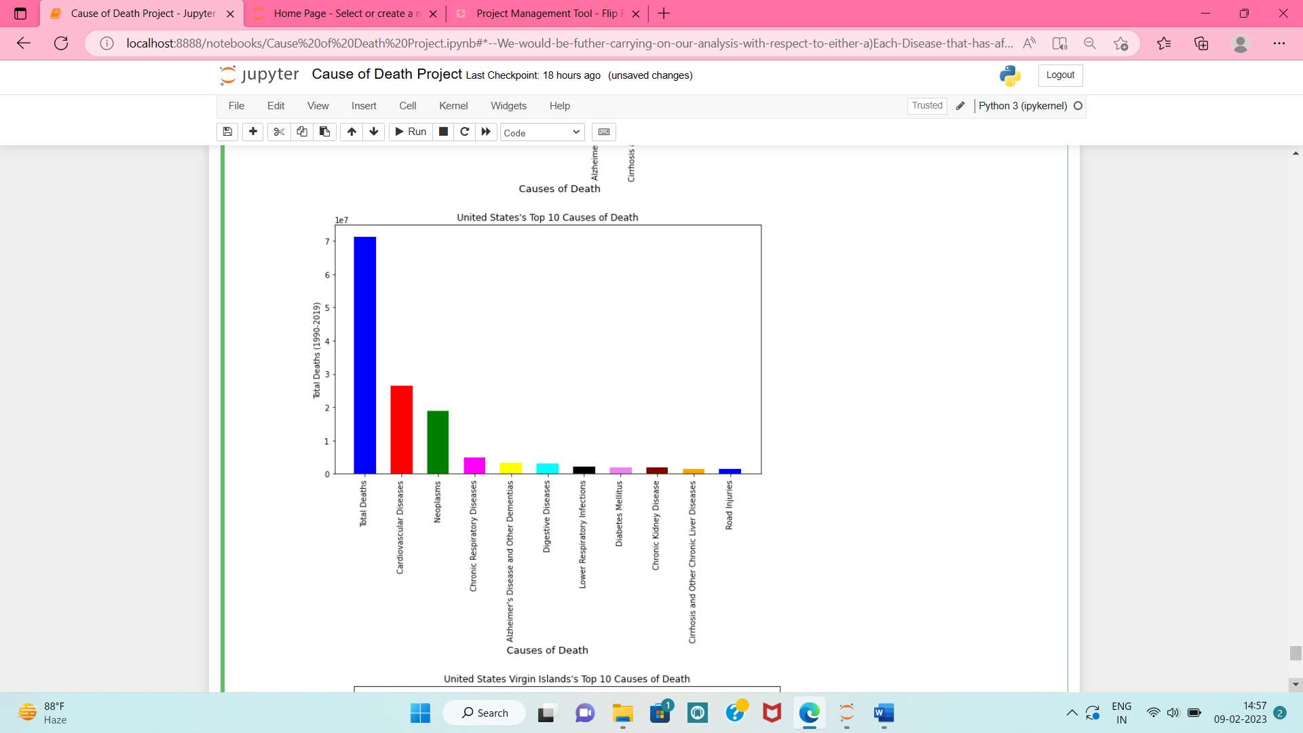

Slide 31
Key Observations:
The main cause of death in most of the countries is "Cardiovascular Diseases".
The second most cause of death in most countries is "Neoplasms".
The other leading causes of deaths are "Chronic Respiratory Diseases", "Lower Respiratory Infections", "Digestive Diseases", "Neonatal Disorders", "Diabetes Mellitus
"Neonatal Disorders" being one of the leading cause of deaths is a deep concern since babies/children dying because of certain problems from birth can be overcome if proper facilities are developed to check for the diseases before birth

Slide 32
Result & Conclusion:
The overall analysis helped in exploring Cause-of- Death of all countries as well as gave Country profile related to the diseases.
Poor healthcare and nutrition are the main reason of deaths in many countries and thus measures for improvement shall be practiced to increase life not just of patients but their family members too.
Neonatal disorders too being one of the top cause of death is a serious concern and shows insufficient facilities for baby or toddlers.

Slide 33
Limitations of this work and Scope for Future Work
There are many factors that can help us in getting much more detailed insights of mortality rate to improve the models’ predictions.
The `biggest limitation of the provided dataset was that there wasn’t any population related data, and thus we could not judge the mortality rate in terms of population percentage.
Also, specifications related to gender, sex, age-group of population would have helped in extracting more meaningful data.

